Slide 1
Basic Details of the Team and Problem Statement
Organization: Govt of Himachal Pradesh
PS Code: SIH1382
Problem Statement Title : Real-Time Vehicle Tracking System
Team Leader Name :Pradeep Kumar
Institute Code : 054
Institute Name : BBDITM
Theme Name: Smart Vehicles

Slide 2
What is Real Time Vehicle Tracking System?
A real time vehicle tracking system is a GPS-based technology that monitors the location and movements of vehicles in real-time.
The system consists of a GPS device that is installed in each vehicle, and a central control center that receives and processes the data from the GPS devices.
The data is displayed on a map, providing a clear visual representation of the location and movements of each vehicle.
Real-time vehicle tracking systems also include additional features such as speed monitoring, route optimization, driver behavior analysis, and real-time notifications.
These features can be customized to meet the specific needs of each business, making it easier to manage and optimize their fleet operations.

Slide 3
Idea and Solutions
Idea:
We are Creating a user-centric smart Vehicle system that aims to revolutionize public transportation.
The system will provide real-time information, promote sustainability, and improve the overall efficiency and convenience of the public transportation network.
Solutions: The solutions for the project are:
Implementing GPS tracking on Vehicles to provide real-time location updates to users.
Utilizing push notifications to inform users of delays, route changes, or other relevant information.
Collaborating with local traffic management systems to access real-time traffic data for route optimization.
Implementing features like interactive maps, journey planning, and user profiles for personalized experiences.
Designing intuitive and user-friendly mobile applications and web portals to allow users to easily access bus information.
Educating users about the benefits of the system and how it can enhance their transportation experience.

Slide 4
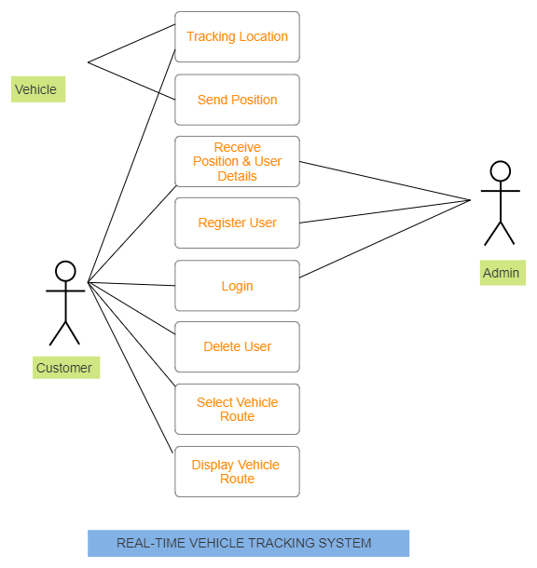
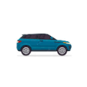
Technology and Use Case Diagram
Technology stack:
Front-end Development (HTML,CSS and JS)
Framework : React.js
Server-Side JavaScript Environment (Node.js)
Database Uses : MySQL, SQLite, MongoDB
Version Control : Git. APIs(Google Map API)
Cloud-Based-Database : Firebase

Slide 5
Use Cases , Dependencies and Stoppers
Use Cases:
Fleet Management
Emergency Services
Public Transportation
Personal Vehicles
Asset Tracking
Personal Navigation
Finding Best Routes
Dependencies:
Hardware
Network Connectivity
Data Transmission Protocols
Geographical Coverage
Data Processing and Analysis
Google Map API
Stoppers:
Data Accuracy and Reliability
Privacy and Security Concern
Costs
Hardware Failure
Data Overload

Slide 6
Conclusions
A real-time vehicle tracking system is a technology that allows you to track the location and movement of vehicles in real-time. This system uses GPS and other technologies to provide accurate and up-to-date information about a vehicle's location and movement. The system can be used in a variety of applications, including fleet management, logistics, and security.
Overall, real time vehicle tracking systems can provide a wide range of benefits to companies, including increased efficiency, improved safety, enhanced customer service, and better fleet management.

Slide 7
Reference Papers
A real-time vehicle detection and a novel vehicle tracking systems for estimating and monitoring traffic flow on highways.
Jahongir Azimjonov, Ahmet Özmen Advanced Engineering formatics 50, 101393, 2021
IOT based real-time vehicle tracking system Abdullah H Alquhali, Mardeni Roslee, Mohamad Y Alias, Khalid S Mohamed
2020 IEEE conference on sustainable utilization and development in engineering and technologies (CSUDET), 265-270, 2020 .
International Journal of Scientific Research in Engineering and Management (IJSREM) Volume: 05 Issue: 10 | Oct - 2021 ISSN: 2582-3930

Slide 8
Team Member Details
Team Leader Name : Pradeep Kumar (2000540100110)
(B.Tech,CSE,IV )
Team Member 1 Name :Rajat Gupta (2000540100123 )
(B.Tech,CSE,IV )
Team Member 2 Name :Raj Chaudhary (2000540100120)
(B.Tech,CSE,IV )
Team Member 3 Name :Rajan Tiwari (2000540100122)
(B.Tech,CSE,IV )

